Slide 1
Virtual Sticky Notes

Slide 2
What are the positive and negative things people said about mentoring?
Positive Feedback
Negative Feedback
It took too long.
Mentoring was fun
The barriers and supports worksheet was boring.
My mentor was very nice.
There weren’t enough breaks.
Everything was very interesting.
It was fun to try new things.
My mentor made me laugh.
Sometimes I got tired. I think it should be shorter.

Slide 3
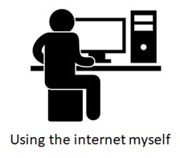
Should we do mentoring online or in person?
Online
In person
In person you can do more fun things.
It will be easier to schedule online.
In person you don’t have to worry about the internet.
It’s easier to meet new people online.
It will be easier to do activities in person.

Slide 4
Prompt/Issue
Category 1
Category 2

